Slide 1

Project Deck
Presenter Name

Slide 2



Agenda
Problem and Business Value
Process and Change Management
Project Milestones and Timeline
Data Sources
Architecture
Model
Results 1
Results 2
Results 3
Challenges and Future Steps

Slide 3
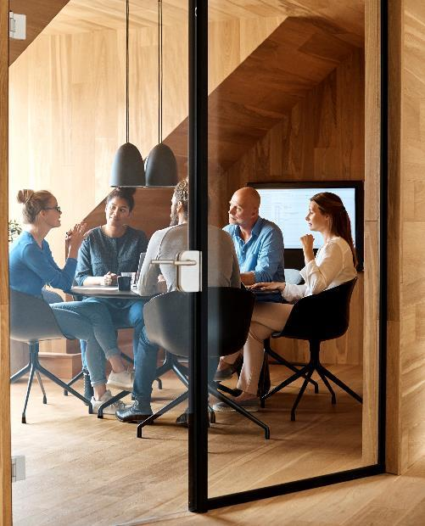



Introduction
With PowerPoint, you can create presentations and share your work with others, wherever they are. Type the text you want here to get started. You can also add images, art, and videos on this template. Save to OneDrive and access your presentations from your computer, tablet, or phone.

Slide 4

Problem
Value Creation
Text
Objective
Text
From:
To:
Previous state/process
New state/process

Slide 5
Process and Standardization and Automation
Subtitle
subtitle
subtitle
Add text, images, art, and videos.
Add transitions, animations, and motion.
Save to OneDrive, to get to your presentations from your computer, tablet, or phone.
Open the Design Ideas pane for instant slide makeovers.
When we have design ideas, we’ll show them to you right there.
Add text, images, art, and videos.
Add transitions, animations, and motion.
Save to OneDrive, to get to your presentations from your computer, tablet, or phone.
Open the Design Ideas pane for instant slide makeovers.
When we have design ideas, we’ll show them to you right there.
Add text, images, art, and videos.
Add transitions, animations, and motion.
Save to OneDrive, to get to your presentations from your computer, tablet, or phone.
Open the Design Ideas pane for instant slide makeovers.
When we have design ideas, we’ll show them to you right there.

Slide 6
Timeline
Title
To start a presentation, go to the Slide Show tab, and select From Beginning.
Title
To display Presenter view, in Slide Show view, on the control bar at the bottom left select the three dots, and then Show Presenter View.
Title
During your presentation, the speaker notes are visible on your monitor, but aren't visible to the audience.
Title
Title
If you don’t see the Notes pane or it is completely minimized, click Notes on the task bar across the bottom of the PowerPoint window.
The Notes pane is a box that appears below each slide. Tap it to add notes.

Slide 7
Data

Slide 8
Architecture

Slide 9
Model

Slide 10
Content
Subtitle
Subtitle
Add text, images, art, and videos.
Add transitions, animations, and motion.
Save to OneDrive, to get to your presentations from your computer, tablet, or phone.
Open the Design Ideas pane for instant slide makeovers.
When we have design ideas, we’ll show them to you right there.

Slide 11
Chart

Slide 12
Table
 | Category 1 | Category 2 | Category 3 | Category 4
Item 1 | 4.5 | 2.3 | 1.7 | 5
Item 2 | 3.2 | 5.1 | 4.4 | 3
Item 3 | 2.1 | 1.7 | 2.5 | 2.8
Item 4 | 4.5 | 2.2 | 1.7 | 7

Slide 13

Summary
With PowerPoint, you can create presentations and share your work with others, wherever they are. Type the text you want here to get started. You can also add images, art, and videos on this template. Save to OneDrive and access your presentations from your computer, tablet, or phone.

Slide 14




Team
Name
Name
Name
Name
Title
Title
Title
Title

